Slide 1
After Repair Property Value Prediction Tool
(Patent Pending)
ARV Holdings LLC

Slide 2
Background and Theory

Slide 3




Real Estate Industry Background
Technology is rapidly revolutionizing every aspect of the real estate industry:
Property databases access
Remotely signed contracts
Market analyses online
Drones aerial photos
One thing still eludes automation:
Accurate pricing estimations
Notes:
2021 Updated Zestimate Updates:
4-26-2021 USA Median Home Price: $276,717 -https://www.zillow.com/home-values/
2021 Zillow Zestimate Median Error: 7.3% -https://www.zillow.com/z/zestimate/
2021 Zillow Zestimate Median Error: ($276,717) *(7.3%) = ±$20,200
Image sources:
cartoon home images - Bing images
https://www.vectorstock.com/royalty-free-vector/sql-database-icon-logo-design-ui-or-ux-app-vector-17507750
https://www.logolynx.com/topic/docusign
https://www.underconsideration.com/brandnew/archives/new_logo_for_zillow.php
https://informationsecuritybuzz.com/news/5-reasons-not-move-cloud/

Slide 4
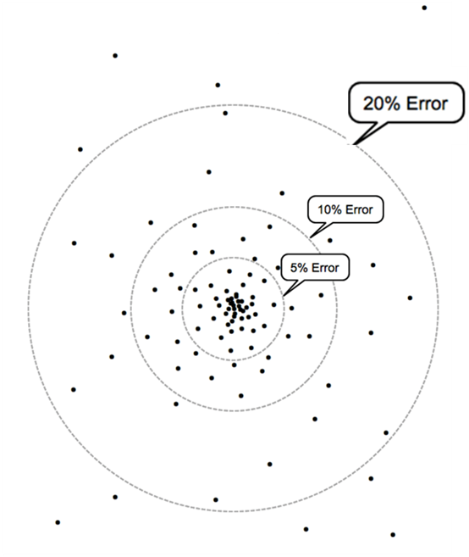
An Industry-Wide Problem: Zestimate® Model Accuracy is Insufficient for Investors
Zillow® Errors Plot
Median Error:
7.3% (± $20,200)
18% of Zillow® Zestimates® have a greater than 20% error
Profit margins of property renovators typically only 10%-12%.
Why so hard?
Property Location: (solvable) ✓
Property Features: (solvable) ✓
Property Condition: (insufficient data) ✖
Notes:
Over estimating the post-renovation value of the transaction by 20% would be disastrous to an investor’s renovation business.
10% Profit margin explanation:
The renovator rule of thumb in property flipping is to purchase a property no more than 70% * ARV – repair costs. But the renovator doesn’t earn 30% of that of profit, additional costs as a percentage of ARV must be subtracted.
These are estimated to be (assuming a 6 month project from purchase to sale):
2% closing costs at purchase
3% Realtor fee to purchase
3% closing costs at sell
3% Realtor fee to sell
5% financing costs (10% annual interest rate * 6 months)
4% holding costs (mortgage, taxes, insurance, and utilities)
= 20% total costs as a percentage of ARV*
* Does not include taxes on profits. Purchasing costs will be slightly lower depending on how deeply discounted the property is.
Properties are valued based on adjustments to sold comparables:
What makes automatic property valuations so hard? Data on 3 main factors is required to accurately estimate a property.
Location: (solvable) Solvable with clustering by census tracts and normalization
Feature Sets: (solvable) Estimatable with subject knowledge
Condition: (problematic) Requires data that is not typically available; up to date condition of property interiors)

Slide 5
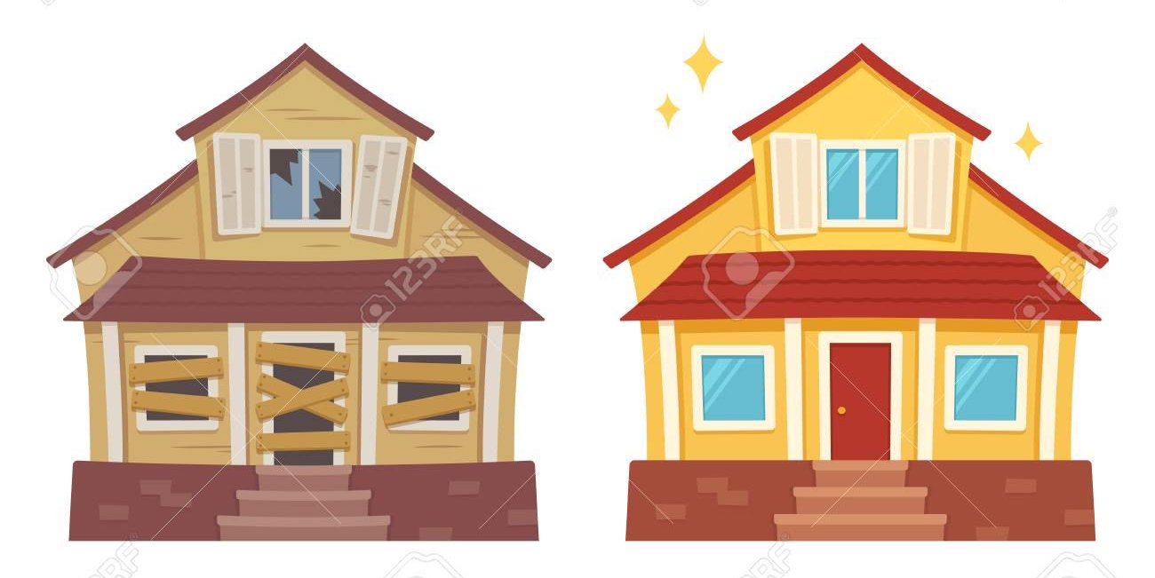
Solution: Automation of After Repair Valuation (ARV)
What is ARV?
“After-Repaired Value” is a pricing metric of a property’s fully renovated value
Why ARV?
All professionally renovated properties have an identical condition (brand new).
Property Location: (solvable)
Property Features: (solvable)
Property Condition: (insufficient data)
Hypothesis:
An ARV model will have reduced errors compared to a similar price prediction model that is using all other sold properties
Notes:
Finding the ARV of properties by comparing only renovated comparables allows us to remove the problematic property condition variable as a factor.

Slide 6
Implementation

Slide 7

Data: Red Cedar Real Estate®
What: A small local Real Estate brokerage firm in Maryland
Data Access: 6 years (2013 – 2019) of Maryland sold property data:
800 fields
330,000 rows
Notes:
Identified Market Need: Noticed that their industry lacked the specialized tools, knowledge, and data to fully assist their clients such as lenders, renovators, and real estate agents.

Slide 8






ARV Estimator Process
SQL call to remotely import Data
Process Property Data
Derive Renovation Term weights using TfidfVectorizer
Identifying Renos Vs. non-Renos
Geo-coding Lat/Lon to Census Tract Script
Variables normalized to by Tract
13% determined
Predict renovation status with classification model
Predict ARV with regression model
Visualize ARVs on a Web Tool
Notes:
ARV Model will display the ARV for common property setups of each census tract (bed-bath-sqft-garage etc.)
Image sources:
https://www.vectorstock.com/royalty-free-vector/sql-database-icon-logo-design-ui-or-ux-app-vector-17507750
https://www.census.gov/
https://commons.wikimedia.org/wiki/File:Microsoft_Excel_2013-2019_logo.svg
https://www.realtor.com/
https://en.wikipedia.org/wiki/Scikit-learn

Slide 9
Deriving Ground Truth for Renovation Status
Identifying Renovations
Identifying Non Renovations
While there is no “Renovated” field, there is a condition field:
626 unique tags
Usually left blank
Only the “Renov/Remod” tag consistently refers to properties that have been newly renovated.
The 2% of properties with this tag became our ground truth for Renovation = 1.
Similarly, there were a set of less flattering tags that typically denoted a property in poor condition:
“Major Rehab Needed”
“Needs Work”
“As-Is Condition”
The 11% of properties with these tags became our ground truth for Renovation = 0.

Slide 10
Renovation Classification Model Results

Slide 11
A Peak Under the Hood: Renovation Classification Models Tested
Classification Model | F1score | Accuracy
Linear SVC | 83.8% | 95.0%
Logistic Regression Classifier | 83.6% | 94.8%
Extra Trees Classifier | 81.8% | 94.2%
SGD Classifier | 81.8% | 93.8%
Random Forest Classifier | 81.7% | 94.4%
Linear Support Vector Classification (SVC) stood out as the best performing classifier.
F1Score: A single metric that balances the precision and recall metrics in one number (higher is better)
F1Score is the more important metric because of the unbalanced classes (85/15)
Accuracy: A metric that measures how close the model results are to the true values (higher is better)

Slide 12
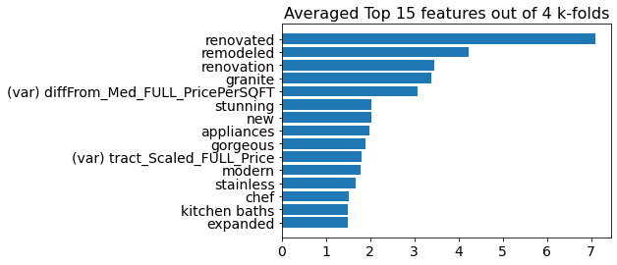
A Peak Under the Hood: Linear SVC Renovation Classification Performance
Methodology:
Results were summarized by averaging the scores obtained from a k-fold cross-validation run.
Accuracy: 0.950 ±0.008
F1score: 0.838 ±0.021
Notes:
TFIDF: “Term Frequency Inverse Document Frequency”

Slide 13
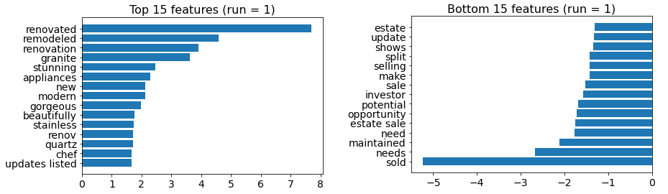
A Peak Under the Hood: Linear SVC Renovation Feature Importances
Property Descriptions fed into the TfidfVectorizer() function to derive weights indicating renovation status.
Renovated.
Vibrant words like "granite", “stunning”, “gorgeous”, or ”stainless” are strong indicators of a renovated property.
Non-Renovated.
Characteristics of the sale itself like “estate sale”, “investor”, “opportunity”, or “sold” indicate a non-renovated property.
Notes:
TFIDF: “Term Frequency Inverse Document Frequency”

Slide 14
ARV Regression Model Results

Slide 15
A Peak Under the Hood: Raw ARV Regression Models Compared
Regression Model | R2 Score | 50th Percentile of Absolute Errors | 75th Percentile of Absolute Errors
Extra Trees Regression | 0.851 | 6.62% | 12.85%
Random Forest Regression | 0.840 | 6.87% | 13.24%
Gradient Boosting Regression | 0.817 | 7.84% | 14.28%
KNN Regression | 0.737 | 8.85% | 16.73%
Linear Regression | 0.780 | 10.80% | 19.97%
Extra Trees stood out as the best performer for the ARV Regression model.
R Squared (R2) metric:
The “correct” metric for regression model evaluation
Percentile errors metric:
Typically the only metric that other sources of home price prediction models are reported
(Results trained/tested on an 80/20 split)
Notes:
Research corroborates that tree-based regression models outperform in home pricing models.

Slide 16
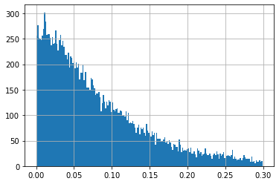
A Peak Under the Hood: Extra Trees Regression Model Performance
Bins of Properties by Percent Error
Methodology:
Results were obtained using a train-test method on an 80/20 split.
Number of Properties per Bin
Percentile Errors:
25%: 0.0297
50%: 0.0662
75%: 0.129
R2Score: 0.983
Percent Error
The predicted value of most renovated properties are within 5% - 10% of the true value, with some properties having greater errors on the tail end.
Notes:
TFIDF: “Term Frequency Inverse Document Frequency”

Slide 17
Comparison of ARV Model with Generic Value Models

Slide 18
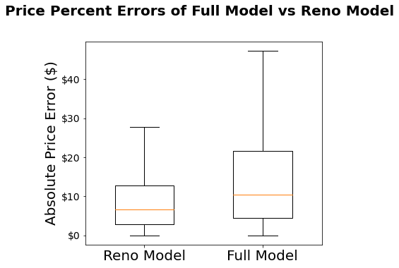
Full Model Errors vs ARV Model Errors
A large drop in the price prediction errors from 10.38% to 6.62% resulted when the regression model was performed on only the renovated data as opposed to the full data set
Why: The ARV model predicts a property’s post-renovation value, which is less error prone than predicting current value.
Full Model Median Error Rate: 10.38%
ARV Median Error Rate: 6.62%
Data used for Extra Trees Regression Model | R2 Score | 25th Percentile of Absolute Errors | 50th Percentile of Absolute Errors | 75th Percentile of Absolute Errors | Mean Dollar Error | Median Dollar Error
Full Data | 0.854 | 4.55% | 10.38% | 21.66% | $45,100 | $26,138
Renovated Data | 0.851 | 2.93% | 6.62% | 12.85% | $42,214 | $20,425
Notes:
The difference however did not meet the threshold for statistical significance via the Welch's t-test

Slide 19
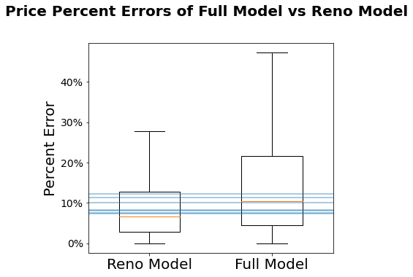
Full Model Errors vs ARV Model Errors vs Researched Model Errors
The accuracy of the ARV model exceeded accuracy scores of all the price prediction models found in the researched literature, including Zillow’s Zestimate model.
Median Error Rates of researched price prediction models: 7.3% -12.27%
ARV Median Error Rate: 6.62%
Notes:
Zillow’s median error: 7.3%

Slide 20
The End Game

Slide 21
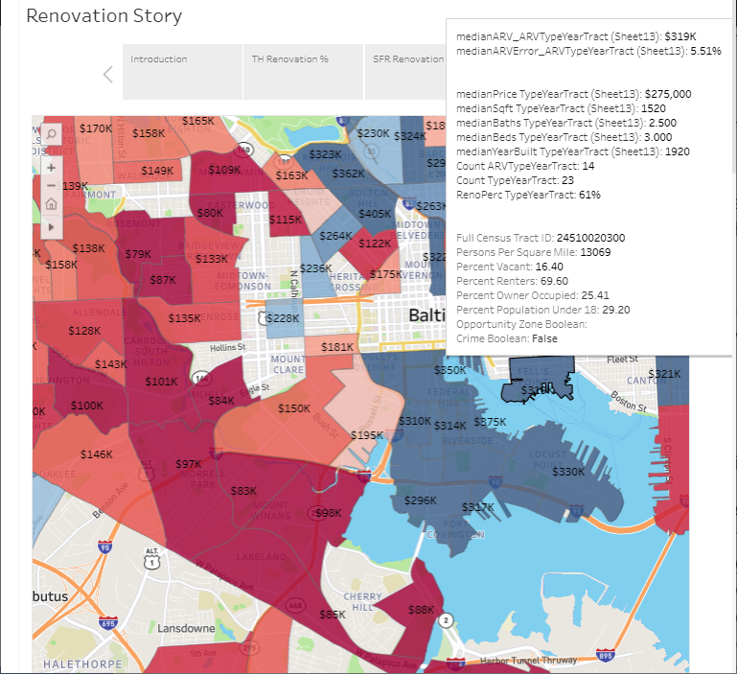
Potential ARV Visualizations: Aggregated into a Tableau® Map
To the left is a snippet of the ARV values of census tracts in Baltimore.
Blue tracks have higher ARV $ amounts than red.
Notice the clear difference in values between Federal Hill (the blue peninsula) and West Baltimore.
Note: Data displayed in mouseover is currently pre-COVID
https://public.tableau.com/profile/joe8009#!/vizhome/RenovationProject/RenovationStory?publish=yes
Notes:
https://public.tableau.com/profile/joe8009#!/vizhome/RenovationProject/RenovationStory?publish=yes

Slide 22
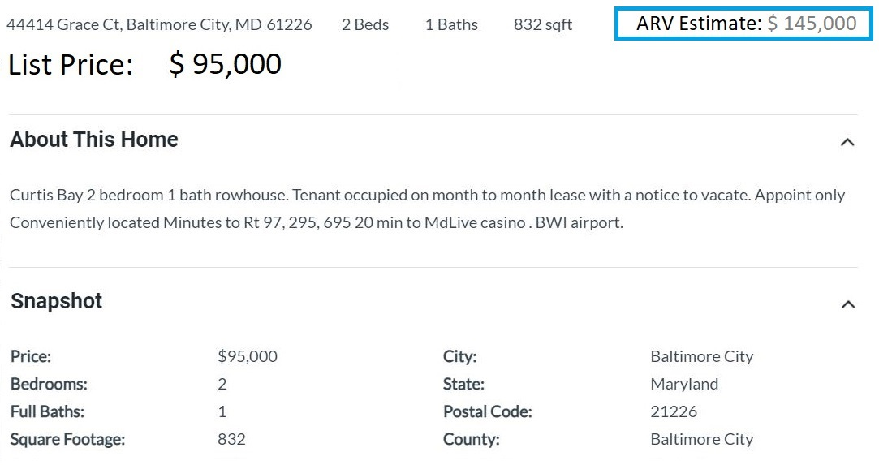
Potential Visualizations: Posted Individually on Website

Slide 23
Big Lesson Learned

Slide 24
Big Lesson Learned: Complexities in Value From Variable Interactions
It is very easy to determine the linear impact of a variable on property value for most regression models. What is more difficult, is determining the impact of the interactions between variables on property value.
It was found that big gains in price prediction accuracy could be found by experimenting with adding new derived variables that account for these interactions
See the next two slides that found big gains in prediction accuracy by simply deriving new variables that identify these interactions

Slide 25
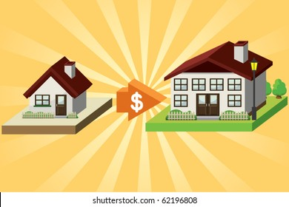
Big Lesson Learned: Complexities in Value From Variable Interactions
diffFrom_Med_ARV_SqftPerc
This variable calculates the percentage difference in square footage between the subject property and the average of its immediate neighbors.
Observation: Prices are disproportionately higher for a house that is larger than others immediately nearby than would be predicted using just square footage alone.
Insight: People are willing to pay disproportionately more for a property just because is bigger than their immediate neighbors.
Notes:
Image Source:
https://www.google.com/imgres?imgurl=https%3A%2F%2Fimage.shutterstock.com%2Fimage-vector%2Fbuy-new-house-260nw-62196808.jpg&imgrefurl=https%3A%2F%2Fwww.shutterstock.com%2Fsearch%2Fbig-house-cartoon&tbnid=kRqH6loHL1lirM&vet=12ahUKEwj-8sn63bX5AhXPrXIEHe7ACCwQMygJegUIARDdAQ..i&docid=gBZPxB_lXe-M2M&w=390&h=280&q=cartoon%20small%20house%20vs.%20a%20big%20house&safe=active&ved=2ahUKEwj-8sn63bX5AhXPrXIEHe7ACCwQMygJegUIARDdAQ

Slide 26
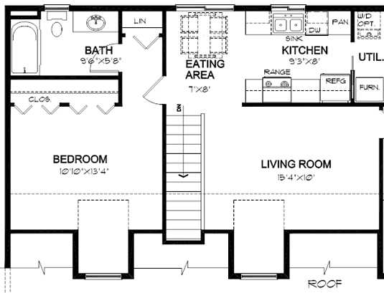
Big Lesson Learned: Complexities in Value From Variable Interactions
SqftPerBaths
This variable calculates the amount of square feet per bath
Observation: Prices are disproportionately higher for properties with smaller square feet per bath than would be predicted by just including the number of baths and square feet variables alone.
Lesson Learned: People are willing to pay disproportionately more to minimize the number of people that have to share a bathroom.
Notes:
Image Source:
https://www.google.com/imgres?imgurl=https%3A%2F%2Fimages.familyhomeplans.com%2Fplans%2F30032%2F30032-2l.gif&imgrefurl=https%3A%2F%2Fwww.familyhomeplans.com%2Fgarage-apartment-plans&tbnid=24cha-1dlB-CrM&vet=12ahUKEwiCruH_3rX5AhVln3IEHUMYC6EQMygregUIARD4Aw..i&docid=DrLt-ER6BfSjxM&w=760&h=475&q=3-1%20condo%20plans&safe=active&ved=2ahUKEwiCruH_3rX5AhVln3IEHUMYC6EQMygregUIARD4Aw

Slide 27
Future of ARV Prediction Tool
Anticipated Impact: Easier for real estate investors to find their next distressed house to renovate to its full potential.
Ideas for future optimizations:
Zero-shot classifier as substitute for matching description text to renovated properties
Use deep learning techniques from PyTorch to improve renovation classification model
Post code and create Kaggle competition to crowdsource the optimize for the ARV Regression model.

Slide 28
Questions?
I can be reached via email or LinkedIn for further discussion.
https://www.linkedin.com/in/joseph-girsch-6b664876/
realcashflowjoe@gmail.com

Slide 29
Appendix

Slide 30



Tools and Methods
SQL Code: Remote server interaction
Base Python: Data Cleaning
Natural Language Toolkit (NLTK): agent remarks processing
Subject Matter Expertise: Determining how much to adjust for different property features
Machine Learning models (scikit-learn): Predicting renovation status
Census Geocoder Package: Converts latitude and longitude coordinates to Census Tracts
Tableau: A visualization vector for the ARVs

Slide 31
Median Absolute Error Rates of All Models
Model | Median Absolute Error
Kummerow’s OLS model | 12.27%
Clapp’s Local Regression | 11.31%
This Project’s Model (Full Data) | 10.38%
Freddie Mac Model-Use Requirement | 10.00%
Dubin’s Kriging Model | 8.34%
Case’s Homogeneous Districts | 8.07%
Kintzel’s Random Forest | 7.60%
Zillow | 7.30%
This Project’s Model (Renovation Data) | 6.62%

Slide 32
Reflections and Future Work
Most rewarding insight: Realization that collaboration with investors yielded unconventional performance improvements
Future Work: Build a similar model to identify properties that need “full-gut” repairs.

Slide 33
Works Cited
Russell, S. (2020, April 11). Are Zillow Zestimates Accurate? Retrieved April 26, 2021, from Freestone Properties: https://www.freestoneproperties.com/blog/truth-zillow-zestimates/
Kintzel, J. (2019). Price Prediction and Computer Vision in the Real Estate Marketplace. Retrieved March 25, 2021, from Harvard Library: https://dash.harvard.edu/bitstream/handle/1/37365260/KINTZEL-DOCUMENT-2019.pdf?sequence=1&isAllowed=y
Modern Machine Learning Algorithms: Strengths and Weaknesses. (2019). Retrieved November 28, 2020, from Elite Data Science: https://elitedatascience.com/machine-learning-algorithms#classification
Ortner, A. (2020, May 28). Top 10 Binary Classification Algorithms [a Beginner’s Guide]. Retrieved November 28, 2020, from Medium: https://medium.com/@alex.ortner.1982/top-10-binary-classification-algorithms-a-beginners-guide-feeacbd7a3e2
Wake, J. (2016, July 8). Zillow’s Typical Error Is $18,000. Retrieved 11 27, 2020, from Real Estate Decoded: https://realestatedecoded.com/zillows-typical-error/
Zillow: Machine learning and data disrupt real estate, Krigsman, https://www.zdnet.com/article/zillow-machine-learning-and-data-in-real-estate/
What Is The MLS? Multiple Listing Service 101: Real Estate Skills. (n.d.). Retrieved November 08, 2020, from https://www.realestateskills.com/blog/mls-multiple-listing-service

